Slide 1

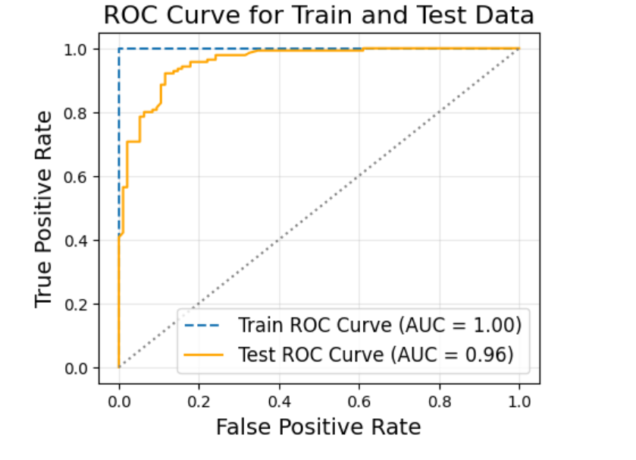
Implementing Random Forest Model on the dataset (without Explicit tuning)
Target variable – Diagnosis
Features – All the indicative variables like Age, BMI etc
Functions used: train_test_split (test_size=0.3), RandomForestClassifier
Parameters: n-estimators=100, max_depth= none.
Observations:
Perfect training data curve of 1.00 suggests the model may be overfitting and has learned very specific patterns.
This could be because the trees in the Random Forest model are overly complex and are memorizing the training data instead of generalizing.
Bhagyashri Gaikwad

Slide 2
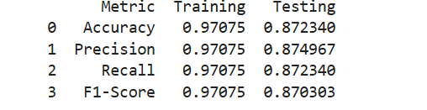
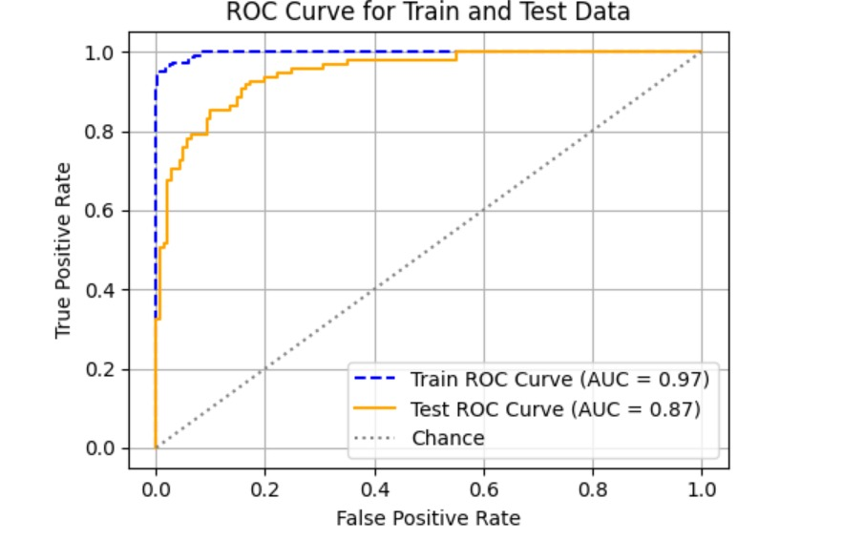
Implementing Random Forest Model on the dataset with Hyperparameter Tuning
Need for hyperparameter tuning: The choice of hyperparameters can significantly affect a model's accuracy, precision, recall, and other metrics, hence I tried using different parameter length for number of trees and the max_depth to reduce overfitting and analysing role of features in diagnosis.(all the features were used)
Functions: GridsearchCV, roc_curve, auc
We set the range for the hyperparameter tuning to
'n_estimators': [50, 100, 150]
'max_depth': [10, 20],
'min_samples_split': [2, 5, 10]
Despite changes in the parameters the gap between the train and test AUC values suggests some degree of overfitting

Slide 3
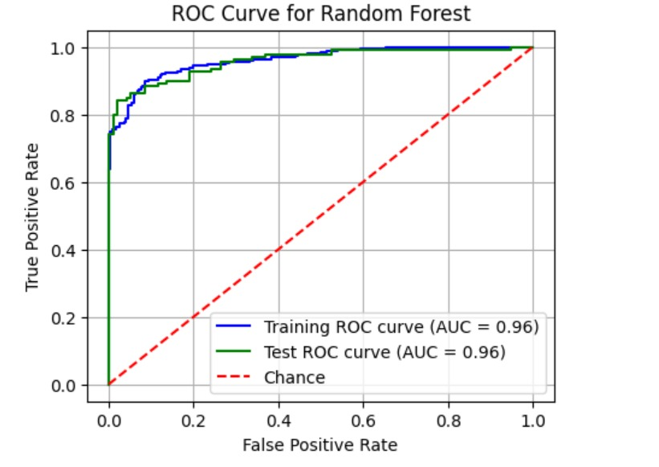
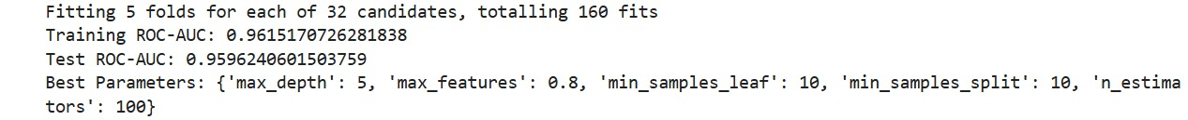
Implementation of the Random Forest with the Important Features
During hyperparameter tuning of the following model, I cleaned/ reduced the data mainly the less important features and focused on indicative features of the diagnosis. My main goal was to reduce the max_depth and the noise data.
The Alvarado_score and the length of stay was exclusively removed during training this model because alvarado score is derived from other features of the dataset and it could lead to data leakage, where model could learn from the features it shouldn't have access at predictive stage.
The model’s high and consistent ROC-AUC values indicate that it’s effective and robust. The reduction of irrelevant features has simplified the model while maintaining its predictive power, which is ideal for practical applications.
Functions used :Training-Test Split- to split data into training and test data
cross_val-to evaluate different hyperparameters on multiple data.
K=5 (5 fold classification was used)
param_grid = n_estimators: [50, 100],
max_depth: [2, 5],
min_samples_split: [10, 15],

Slide 4
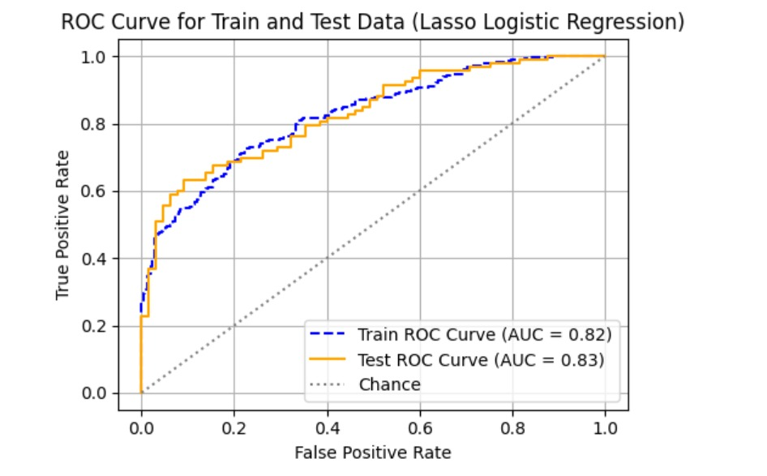
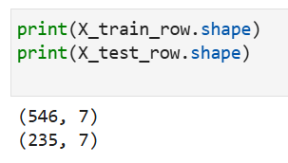
Implementation of the Lasso Logistic regression with the dataset
Lasso (L1 Regularization) shrinks coefficients of less important features to zero, effectively performing feature selection and reducing overfitting.
For the following algorithm data was scaled,7 features were used and split into training and test data set.
Functions used: logisticRegression
Lasso Logistic Regression provides interpretable models by retaining only the most important features, making it easier to understand how specific variables influence the prediction.
.

Slide 5
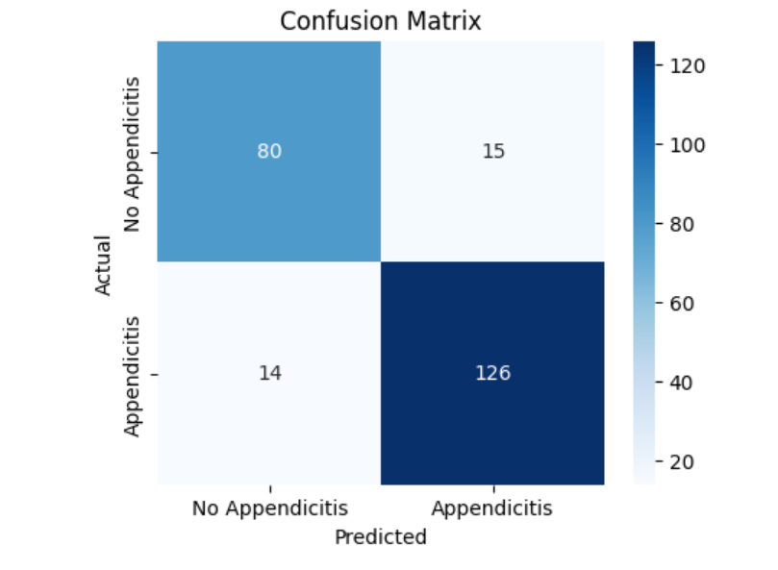
Confusion Matrix for Random forest
True Negatives (TN = 80):
The model correctly predicted No Appendicitis for 80 cases.
The model correctly predicted Appendicitis for 126 cases.
False Negatives (FN = 15):
The model incorrectly predicted No Appendicitis for 15 cases that actually had appendicitis.
False Positives (FP = 14):
The model incorrectly predicted Appendicitis for 14 cases that actually did not have appendicitis.
True Positives (TP = 126):
The model incorrectly predicted Appendicitis for 14 cases that actually did not have appendicitis.
The confusion matrix highlights that the model is slightly better at predicting appendicitis (Class 1) than no appendicitis (Class 0) based on the recall values.

Slide 6
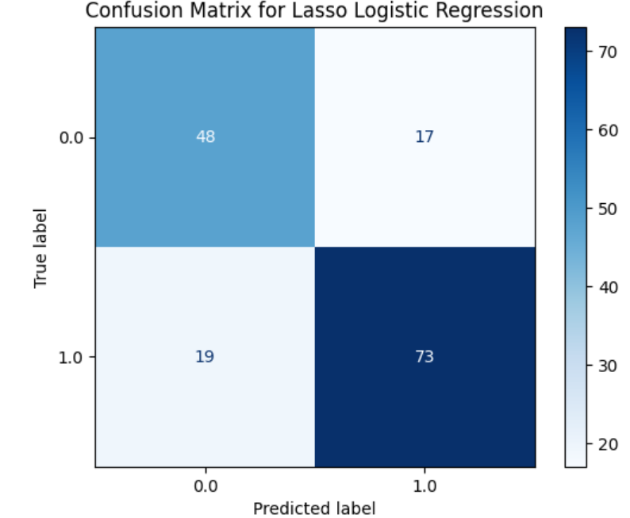
Confusion Matrix for Lasso logistic Regression
True Negatives (TN = 48):
The model correctly predicted "No Appendicitis" for 48 cases.
True Positives (TP = 73):
The model correctly predicted "Appendicitis" for 73 cases.
The model incorrectly predicted "No Appendicitis" for 19 cases that actually had appendicitis.
False Positives (FP = 17):
The model incorrectly predicted "Appendicitis" for 17 cases that actually did not have appendicitis.
False Negatives (FN = 19):
The model incorrectly predicted "Appendicitis" for 17 cases that actually did not have appendicitis.
It indicated the model has balanced performance but higher false negative rate.

Slide 7
Evaluation of the Models used
Metric | Lasso Logistic Regression | Random Forest
ROC-AUC (Train) | 0.82 | 0.967
ROC-AUC (Test) | 0.83 | 0.956
Performance Gap | Minimal (Good generalization) | Minimal (Good generalization)
Interpretability | High (Feature coefficients) | Moderate (Feature importance)
Handling Non-linearity | Poor | Excellent (Non-linear model)
Feature Selection | Yes (L1 regularization) | No explicit selection (all used)
Complexity | Low | High

Slide 8
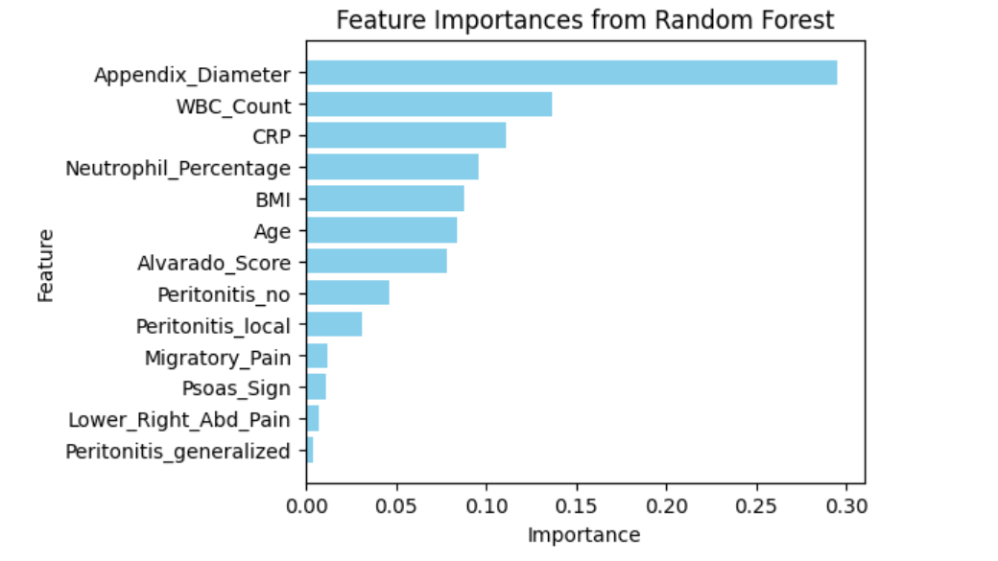
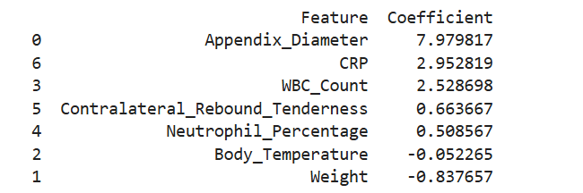
. Initial Hypothesis on Dataset
Hypothesis: We assumed that certain clinical indicators (e.g., appendix diameter, or biomarkers like CRP) might be key predictors of the diagnosis.
We observed that both the models had certain predictive features for the diagnosis of the disease.
After model selection, model training and understanding what we could of how the model works we are making predictions that features such as Appendix-Diameter, Wbc, CRP are among most important clinical indicators for diagnosis of Appendicitis.
We used functions such as lasso_log_coef for lasso logistic regression and best_rf_model.feature_importances_ for Random forest model to find the most predictive features, which gave us the following results.

Slide 9
Conclusion
Model-Specific Insights:
Random forest is high performing model useful in automated systems or large care clinical setups.
It can also link non linear features providing wide range for model training.
Lasso logistic Regression:
Offers interpretable features for healthcare workers for Diagnosis of appendicitis based on the important clinical features.
CRP , WBC and Appendix Diameter constantly emerged as top predictors in both the model training.
Limitations or what else can we try
Comparison with different models.
Domain expertise advice
Threshold adjustment

